Slide 1
EXPRESSIONS
Expressions

Slide 2
Today’s Agenda
Topics:
Prompting the User for Input
Expressions
Arithmetic Expressions
Relational Expressions
Logical Expressions
Reading:
Java how to program Late objects version (D & D)
Chapter 2 & Chapter 3
The Java Tutorials
Lesson: Language Basics: Operators, Expressions, Statements, and Blocks
https://docs.oracle.com/javase/tutorial/java/nutsandbolts/index.html
Welcome to Java for Python Programmers
http://interactivepython.org/courselib/static/java4python/index.html

Slide 3
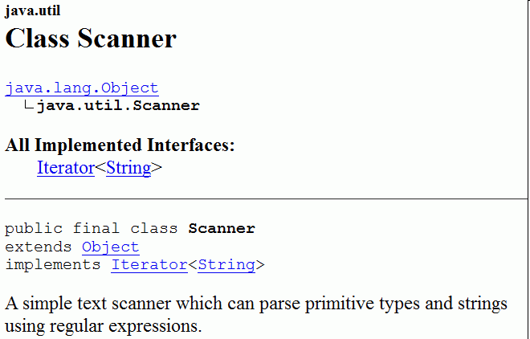
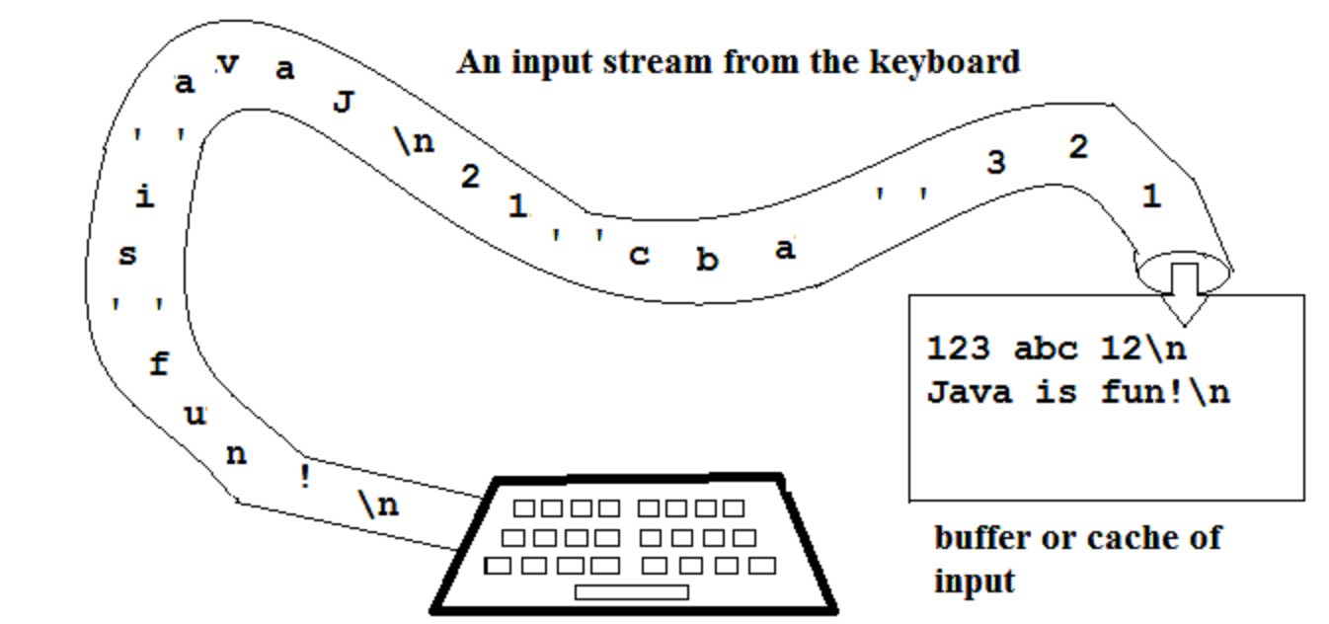
1.Prompting the User for Input
A Java program can obtains inputs from the console through the keyboard.
The variable named System.in represents the keyboard
There is a lot of work that the computer must do to read in a number
The Java programming language provides a collection of methods stored in the Scanner class that perform read operations.

Slide 4
1.Prompting the User for Input Declaring and Creating a Scanner
L03Code.java
Importing the Scanner class definition
Scanner is in a package named java.util
To use Scanner, you must place the above line at the top of your program (before the public class header).
Constructing a Scanner object to read console input:
The new keyword creates an object.
Standard input object, System.in, enables applications to read bytes of data typed by the user.
Scanner object translates these bytes into types that can be used in a program.
import java.util.Scanner;
Scanner console = new Scanner(System.in);

Slide 5
1.Prompting the User for Input Scanner methods
After having constructed the Scanner object named in:
Display a prompt: - A message telling the user what input to type.
Use one of the following methods to read from the keyboard:
Each method waits until the user presses Enter.
The value typed is returned.
You must save (store) the number read in a variable with an assignment statement
Method | Description
nextInt() | reads a token of user input as an int
nextDouble() | reads a token of user input as a double
next() | reads a token of user input as a String
nextLine() | reads a line of user input as a String
System.out.print("How old are you? "); // prompt
int age = console.nextInt();
System.out.println("You'll be 40 in " + (40 - age) + " years.");

Slide 6
1.Prompting the User for Input Example 1
Summarizes the programming steps to read in a number:
1. import the Scanner class
2. Construct a Scanner object
3. Display a prompt message
3. Define a variable to receive the value
4. Read input
How old are you? 65
65... That's quite old!
import java.util.Scanner;
public class L02Code {
public static void main(String[] args) {
Scanner console = new Scanner(System.in);
System.out.print("How old are you? ");
int age = console.nextInt();
System.out.println(age + "... That's quite old!");
}
}

Slide 7
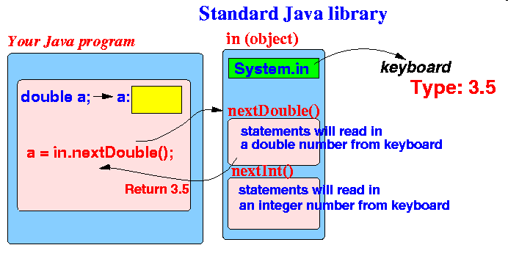
1.Prompting the User for Input Example 2
Reading a floating point number from the keyboard:
How old are you? 65
65... That's quite old!
import java.util.Scanner;
...
Scanner console = new Scanner(System.in);
...
double x = console.nextDouble();

Slide 8
2.Expressions
An expression is code that can be evaluated to give a single value:
Combination of variables, constants, operators, and parentheses
Examples of expressions
Arithmetic Expressions
Relational Expressions
Logical Expressions
35
age
3 * number + 56
age / value + (number - age)

Slide 9
3. Arithmetic Expressions The Arithmetic Operators
Arithmetic expression
Combine variables and constants with arithmetic operators and parentheses
Note:
The arithmetic operators are binary operators because they each operate on two operands.
Integer division yields an integer quotient.
Any fractional part in integer division is simply truncated (i.e., discarded)—no rounding occurs.
The remainder operator, %, yields the remainder after division.
Operator | Description
+ | Additive operator (also used for String concatenation)
- | Subtraction operator
* | Multiplication operator
/ | Division operator
% | Modulus / Remainder operator
10 / 4
Result is 2

Slide 10

3. Arithmetic Expressions Mixing Types
When a Java operator is applied to operands of different types, Java does a widening conversion automatically, known as a promotion.
Conversions are done on one operator at a time in the order the operators are evaluated.
2.2 * 2 | evaluates to 4.4
1.0 / 2 | evaluates to 0.5
double x = 2; | assigns 2.0 to x
5.0
7.16666
3 / 2 * 3.0 + 8 / 3
2.0 * 4 / 5 + 6 / 4.0
3.1

Slide 11
3.Arithmetic Expressions The Unary Operators
Operator | Description
+ | Unary plus operator; indicates positive value (numbers are positive without this, however)
- | Unary minus operator; negates an expression
++ | Increment operator; increments a value by 1
-- | Decrement operator; decrements a value by 1
! | Logical complement operator; inverts the value of a boolean
Example:
int a = 0;
a++;
System.out.println(a);
int b = 4;
b--;
System.out.println(b);
1
3

Slide 12
3.Arithmetic Expressions Post-increment Vs Pre-increment
Post Increment : i++
Increment Value of Variable After Assigning
Pre Increment : ++i
First Increment Value and then Assign Value.
Post-decrement: i--, Pre-decrement: --i
int i = 0, j = -1;
j = i++;
System.out.println(j);
0
int p = 0, q = -1;
q = ++p;
System.out.println(q);
1

Slide 13
Exercise 1
public class L03Ex01{
public static void main(String[] args) {
int num1=100, num2=1, num3;
num3 = num2++ + ++num1;
System.out.print(" num1=" + num1);
System.out.print(" num2=" + num2);
System.out.print(" num3=" + num3);
}
}
What is the output of the following program?

Slide 14
3.Arithmetic Expressions The Assignment Operators
Operator | Description
+= | Add AND assignment operator | C += A is equivalent to C = C + A
-= | Subtract AND assignment operator | C -= A is equivalent to C = C - A
*= | Multiply AND assignment operator | C *= A is equivalent to C = C * A
/= | Divide AND assignment operator | C /= A is equivalent to C = C / A
%= | Modulus AND assignment operator | C %= A is equivalent to C = C % A
Example:
int x = 1;
x += 2;
System.out.println(x);
int y = 8;
y /= 2;
System.out.println(y);
3
4

Slide 15
3.Arithmetic Expressions Multiple assignments
Multiple assignments
Embed assignment expressions within assignment expressions
Example: s = 5 + (t = 4)
Evaluates to 9 while t is assigned 4
int s = 1, t = 2;
s = 5 + (t = 4);
System.out.println(s);
System.out.println(t);
9
4

Slide 16
3.Arithmetic Expressions The + operator
The + operator can be used in two ways.
as a concatenation operator
as an addition operator
If either side of the + operator is a string, the result will be a string.
Example:
int value = 5;
System.out.println("Hello " + "World");
System.out.println("The value is: " + 5);
System.out.println("The value is: " + value);
System.out.println("The value is: " + '\n' + 5);
Hello World
The value is: 5
The value is: 5
The value is:
5

Slide 17
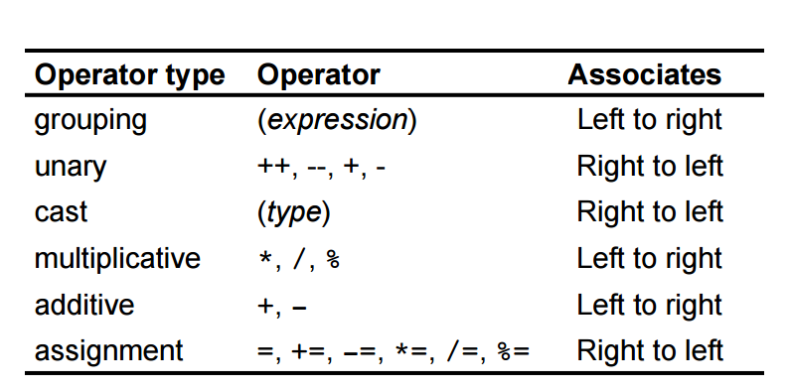
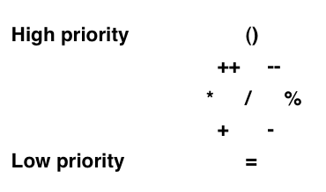
3.Arithmetic Expressions Order of precedence
The evaluation of expressions follows these two rules:
highest precedence operators are always evaluated first
if operators have the same precedence, then evaluation is from left to right

Slide 18
4.Relational Expressions
Relational expressions
Combine variables and constants with relational, or comparison, and equality operators and parentheses
Relational or comparison operators: <, <=, >=. >
Equality operators: ==, !=
Evaluate to true or false
Note: Common programming Error
Confusing the equality operator ‘==‘ with the assignment operator ‘=‘
int value = 5;
System.out.println(value > 5);
false
int value = 5;
System.out.println(a=5);
System.out.println(a==5);
5
true

Slide 19
Exercise 2 & 3
What is the output of the following program?
int a, b;
double c;
System.out.println(7 + 1 + "4 * 2" + 3 + 1);
System.out.println("5" + (7 + 1) + 3 * 2 + 1);
a = 5;
b = a / 3 + 1;
c = a / b;
System.out.println(a + ", " + b + ", " + c);
int val1 = 50;
int val2 = 53;
System.out.println("1. " + (val1 != val2));
System.out.println("2. " + (val1 >= val2 - 3));
System.out.println("3. " + (67 % 2 == 1));

Slide 20
5.Logical Expressions
Logical expressions
Combine variables and constants of arithmetic types, relational expressions with logical operators
Logical And: &&
Logical Or: ||
Logical unary NOT: !
Evaluate to true or false
Note: Comparison operators can be chained
1 < value < 100
value > 1 && value < 100
value >= 1 || value == 5

Slide 21
5.Logical Expressions Order of precedence
Logical operators in the order of precedence
Example: expression a && !b || c would be evaluated as (a && (!b)) || c
Parentheses can be used to change the order of evaluation
Example: a && (!b || c)
Operator
Meaning
Example
high
!
Not
! ( a == b)
&&
And
(a == b) && (c ==d)
low
||
Or
(a == b) || (c ==d)

Slide 22
5.Logical Expressions More Examples
is the value greater than 10 and less than 100
value > 10 && value < 100
is the value greater than 10 or is the value equal to 1
value > 10 || value == 1
is the value not greater than 10
!(value > 10)
(value <= 10)
is the value not greater 10 and not equal to 1
either
value <= 10 && value != 1
or
!(value > 10 || value == 1)

Slide 23
5.Logical Expressions Short-circuit evaluation
 | Meaning | Short circuit?
&& | and | yes
& | and | no
|| | or | yes
| | or | no
Short-circuit evaluation
Stops as soon as the value of expression is determined
Truth table:
The OR operator results in true when A is true, no matter what B is.
Similarly, the AND operator results in false when A is false, no matter what B is.
A | B | And Operator | Or operator
T | T | T | T
T | F | F | T
F | T | F | T
F | F | F | F
true
Skip the second part as the result is always TRUE
System.out.println(a>0 || value>a/0);
true
false
Must evaluate the second part -> generate an error
System.out.println(a>10 || value>a/0);
Exception in thread "main" java.lang.ArithmeticException: / by zero

Slide 24


5.Logical Expressions Common Errors
Mathematics shortcuts do not work in Java.
if (10 < b < 20) {
doSomething();
}
Not valid in Java
if (10 < b && b < 20) {
Remember that the equality test uses double equals ==
if (a = b) {
doSomething();
}
Tries to do assignment
if (a == b) {

Slide 25
Summary Operator Precedence
Operation
Symbol
!
Operations with higher order of precedence are applied first
high
Grouping operators
( )
Higher order of precedence
Unary operators
+, -, !
Multiplicative arithmetic
*, /, %
Additive arithmetic
+, -
Relational ordering
<, >, <=, >=
Relational equality
==, !=
Logical and
&&
Logical or
||
low
Assignment
=, +=, -=, *=, /=, %=

Slide 26

Exercise 4
What is the output of the following program?
public class L03Ex04 {
public static void main(String[] args) {
int value = 12;
boolean result;
result = value>10 || value<=5 && value!=12;
System.out.println("1. " + result);
result = (value>10 || value<=5) && value!=12;
System.out.println("2. " + result);
}
}
!
High Precedence!

Slide 27
Exercise 5
Write a program that averages the rain fall for three months, April, May, and June. Declare and initialize a variable to the rain fall for each month. Compute the average, and write out the results, something like:
//import
public class L03Ex05 {
public static void main(String[] args) {
int april, may, june;
double average;
//create a scanner object
//get rainfall x 3 times
//calculate the average
average = (april + may + june)/3;
System.out.printf("Average rainfall: %.2f%n", average);
}
}
Rainfall for April: 12
Rainfall for May : 14
Rainfall for June: 8
Average rainfall: 11.33
What is wrong here?
Rainfall for April: 12
Rainfall for May : 14
Rainfall for June: 8
Average rainfall: 11.00
!

